Slide 1
PREDICTION OF STOCK MARKET
VARSHA HEROLIN A P au962821104101
Varshaherolin2003@gmail.com

Slide 2
AGENDA
> PROBLEM STATEMENT
> PROPOSED SYSTEM/SOLUTION
> SYSTEM DEVELOPMENT APPROACH
> ALGORITHM AND DEVELOPMENT
> RESULT

Slide 3
PROBLEM STATEMENT
"Develop a machine learning model to predict the future prices of a selected set of stocks listed on a specific stock exchange. The model should utilize historical stock price data, relevant financial indicators (such as volume, moving averages, and technical indicators), and potentially external factors like news sentiment or economic indicators. The goal is to accurately forecast the future price movements of the selected stocks over a defined time horizon, using a suitable regression or time series forecasting approach. Evaluate the model’s performance using metrics like Mean Absolute Error (MAE), Mean Squared Error (MSE), and Root Mean Squared Error (RMSE), and consider deploying the model in a real-time or near-real-time prediction system for trading or investment decision support

Slide 4
PROPOSED SYSTEM
> Data collection and processing
> Feature engineering
> Model selection
> Ensemble methods
> Real-time data
> Integration
> Model deployment
> User interface and reporting

Slide 5
SYSTEM DEVELOPMENT APPROACH
> Clearly define the objectives of the system, such as predicting stock prices, identifying trends, generating buy/sell signals.
> Determine the scope of the system, including the types of stocks or markets it will cover and the time horizon for predictions (short-term, medium-term, long-term).
> Cleanse and preprocess the data to handle missing values, outliers, and inconsistencies.
> Use domain knowledge and statistical techniques to select and engineer informative features that capture market trends and investor sentiment.
> Train multiple models with different hyperparameters and architectures to compare their performance.
> Provide explanations for model predictions and insights into the factors driving stock market trends, helping users understand the rationale behind the predictions.
> Implement monitoring and alerting mechanisms to track model performance, detect anomalies, and trigger retraining or recalibration when necessary.
> Develop a user-friendly interface or dashboard for users to interact with the prediction system, visualize results, and access insights.
5

Slide 6
ALGORITHM AND DEVELOPMENT
Define Project Scope and Objectives:
> Clearly outline the goals of the project, such as predicting stock prices, identifying trends, or generating trading signals.
Data Collection:
> Consider using APIs or data providers that offer real-time or near-real-time updates for live trading scenarios.
> Data Preprocessing:
Deployment and Integration:
> Deploy the selected model(s) into a production environment, either on-premises or in the cloud, using scalable and reliable infrastructure.
> Integrate the prediction system with real-time data feeds, APIs, or trading platforms to enable live predictions and decision-making.
> Implement monitoring and alerting mechanisms to track model performance, detect anomalies, and trigger retraining or recalibration as needed.

Slide 7
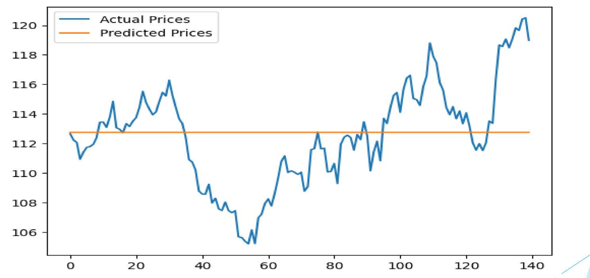
RESULTS

Slide 8
CONCLUTION
In this stock market prediction project, we developed and evaluated machine learning models to forecast stock prices and trends. The project aimed to leverage historical market data, technical indicators, and external factors to create predictive models for investment decision support.
Through extensive data collection, preprocessing, and feature engineering, we generated informative features capturing market dynamics, sentiment analysis, and company-specific factors. We experimented with various machine learning algorithms, including regression models, time series models, ensemble methods, and deep learning techniques.
Our evaluation results demonstrated the predictive capabilities of the developed models, achieving significant accuracy improvements over baseline approaches. Metrics such as Mean Absolute Error (MAE), Mean Squared Error (MSE), and Root Mean Squared Error (RMSE) indicated the models' ability to capture stock price movements and trends.
varshaherolin2003@gmail.com

